Slide 1


Slide 2
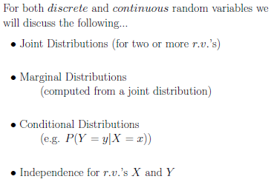

Slide 3
Our study of random variables and their probability distributions in the preceding sections is restricted to one-dimensional sample spaces, in that we recorded outcomes of an experiment as values assumed by a single random variable.
There will be situations, however, where we may find it desirable to record the simultaneous outcomes of several random variables.
For example, we might measure the amount of precipitate P and volume V of gas released from a controlled chemical experiment, giving rise to a two-dimensional sample space consisting of the outcomes (p, v),
We might be interested in the hardness H and tensile strength T of cold-drawn copper, resulting in the outcomes (h, t).
If X and Y are two discrete random variables, the probability distribution for their simultaneous occurrence can be represented by a function with values f(x, y) for any pair of values (x, y) within the range of the random variables X and Y . It is customary to refer to this function as the joint probability distribution of X and Y .
Hence, in the discrete case,
f(x, y) = P(X = x, Y = y);
that is, the values f(x, y) give the probability that outcomes x and y occur at
the same time.

Slide 4
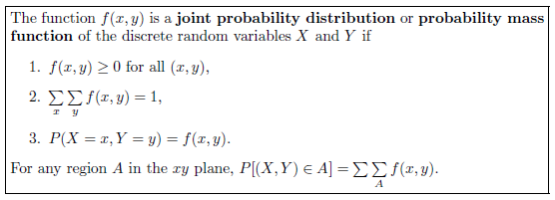
For example, if an 18-wheeler is to have its tires serviced and X represents the number of miles these tires have been driven and Y represents the number of tires that need to be replaced, then f(30000, 5) is the probability that the tires are used over 30,000 miles and the truck needs 5 new tires.

Slide 5
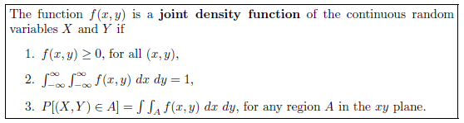

Slide 6

Example: A privately owned business operates both a drive-in facility and a walk-in facility. On a randomly selected day, let X and Y, respectively, be the proportions of the time that the drive-in and the walk-in facilities are in use, and suppose that the joint density function of these random variables is
Verify for the joint probability density function total probability sum is 1.

Slide 7
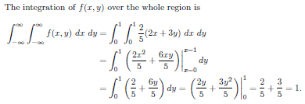
Solution :

Slide 8
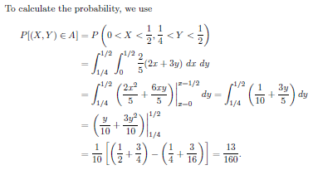

Slide 9
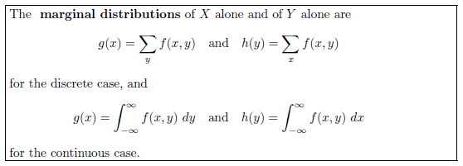
Given the joint probability distribution f(x, y) of the discrete random variables X and Y , the probability distribution g(x) of X alone is obtained by summing f(x, y) over the values of Y . Similarly, the probability distribution h(y) of Y alone is obtained by summing f(x, y) over the values of X.
We define g(x) and h(y) to be the marginal distributions of X and Y , respectively.
When X and Y are continuous random variables, summations are replaced by integrals. We can now make the following general definition.
The term marginal is used here because, in the discrete case, the values of g(x)
and h(y) are just the marginal totals of the respective columns and rows when the values of f(x, y) are displayed in a rectangular table.

Slide 10
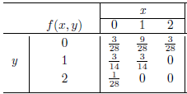
Example: Find the marginal distribution for X and Y for the following joint probability mass distribution.

Slide 11
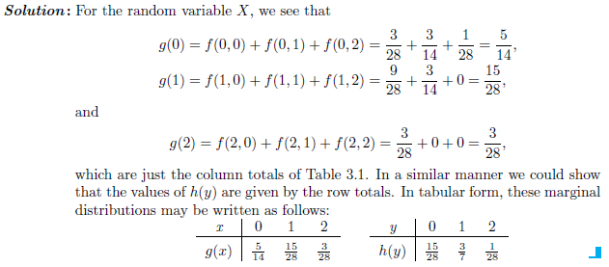

Slide 12
Example: Find the marginal distribution for X and Y for the following joint probability density function.

Slide 13
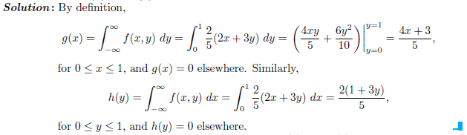

Slide 14


The concept of conditional probability distribution:
The value x of the random variable X represents an event that is a subset of the sample space. If we use the definition of conditional Probability,
where A and B are now the events defined by X = x and Y = y, respectively, then
where X and Y are discrete random variables.
It is not difficult to show that the function f(x, y)/g(x), which is strictly a function of y with x fixed, satisfies all the conditions of a probability distribution. This is also true when f(x, y) and g(x) are the joint density and marginal distribution, respectively, of continuous random variables. As a result, it is extremely important that we make use of the special type of distribution of the form f(x, y)/g(x) in order to be able to effectively compute conditional probabilities. This type of distribution is called a conditional probability distribution; the formal definition follows.

Slide 15
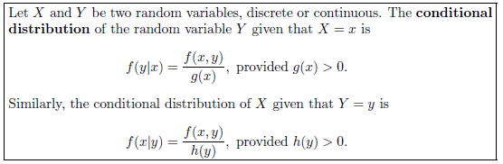


Note:
If we wish to find the probability that the discrete random variable X falls between a and b when it is known that the discrete variable Y = y, we evaluate
where the summation extends over all values of X between a and b. When X and Y are continuous, we evaluate

Slide 16
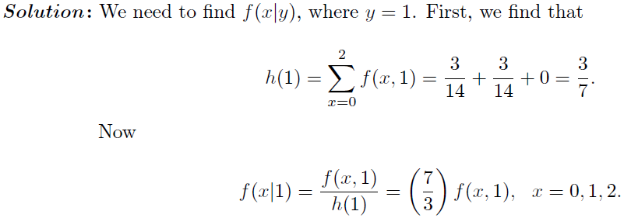
Example: Two ballpoint pens are selected at random from a box that contains 3 blue pens, 2 red pens, and 3 green pens. If X is the number of blue pens selected and Y is the number of red pens selected, find
1. find the conditional distribution of X, given that Y = 1, and use it to determine P(X = 0 | Y = 1).

Slide 17
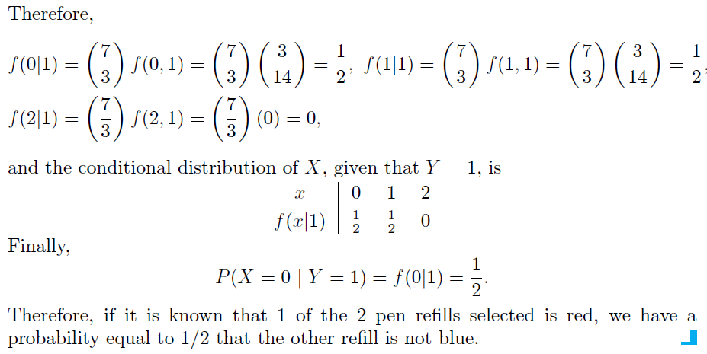

Slide 18
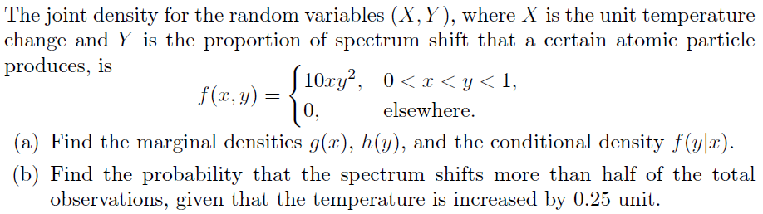
Example

Slide 19
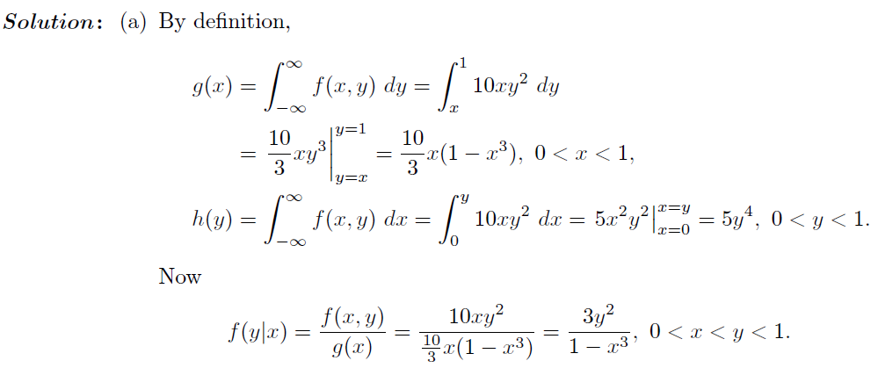
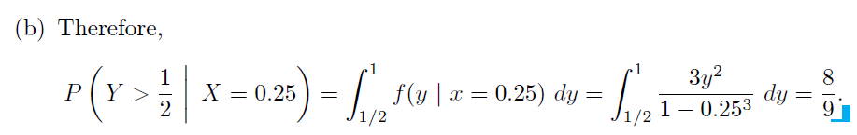

Slide 20
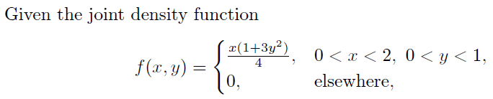
Example

Slide 21
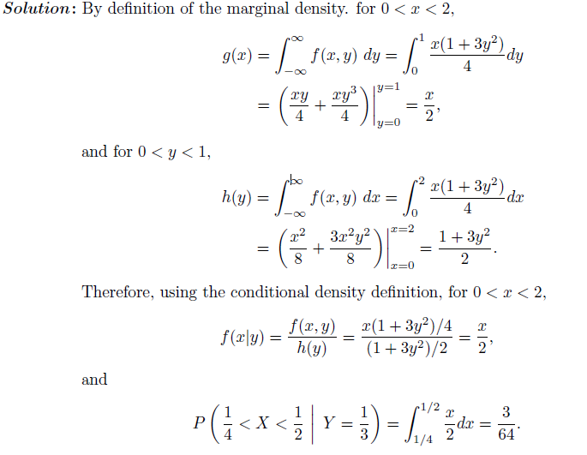

Slide 22
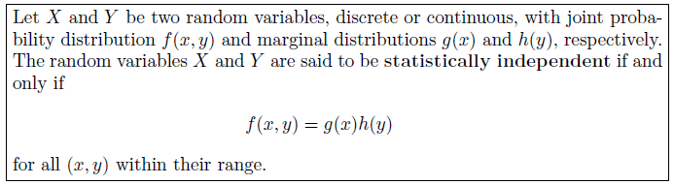
Statistical Independence
Example: Two ballpoint pens are selected at random from a box that contains 3 blue pens, 2 red pens, and 3 green pens. If X is the number of blue pens selected and Y is the number of red pens selected, show that the random variables are not statistically independent.

Slide 23
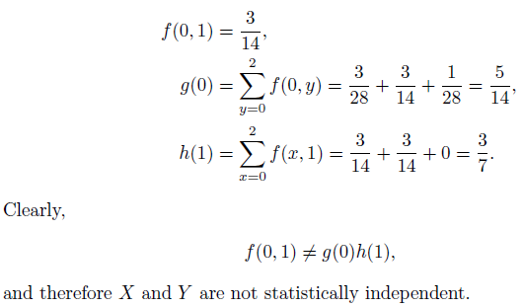
Proof : Let us consider the point (0, 1). Then we find the three probabilities f(0, 1), g(0), and h(1) as follows:

Slide 24



Exercise:
If the joint probability distribution of X and Y is given by
find (a) P(X ≤ 2, Y = 1);
(b) P(X >2, Y ≤ 1);
(c) P(X >Y);
(d) P(X + Y = 4).
2. A fast-food restaurant operates both a drive through facility and a walk-in facility. On a randomly selected day, let X and Y , respectively, be the proportions of the time that the drive-through and walk-in facilities are in use, and suppose that the joint density function of these random variables is
(a) Find the marginal density of X.
(b) Find the marginal density of Y .
(c) Find the probability that the drive-through facility is busy less than one-half of the time.
3. Let X denote the number of times a certain numerical control machine will malfunction: 1, 2, or 3 times on any given day. Let Y denote the number of times a technician is called on an emergency call. Their joint probability distribution is given as
(a) Evaluate the marginal distribution of X.
(b) Evaluate the marginal distribution of Y .
(c) Find P(Y = 3 | X = 2).

Slide 25
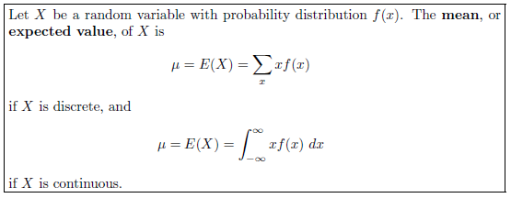
Mathematical Expectation
Mean of a Random Variable (X)

Slide 26
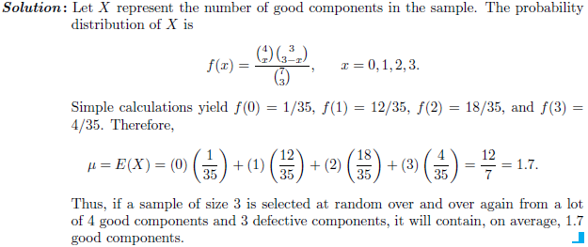
Example: A lot containing 7 components is sampled by a quality inspector; the lot contains 4 good components and 3 defective components. A sample of 3 is taken by the inspector. Find the expected value of the number of good components in this sample.

Slide 27
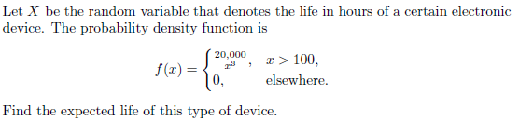

Example:
Therefore, we can expect this type of device to last, on average, 200 hours.

Slide 28
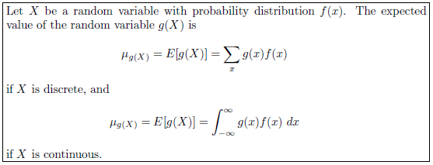
Mean of a Random Variable g(X), which depends on X

Slide 29
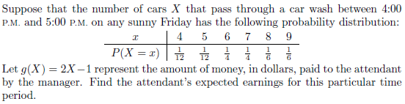
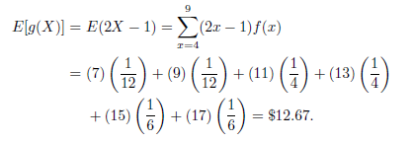
Example:
Solution:
The attendant can expect to receive

Slide 30
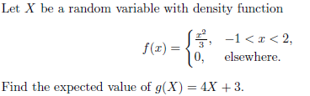

Example:
Solution:

Slide 31
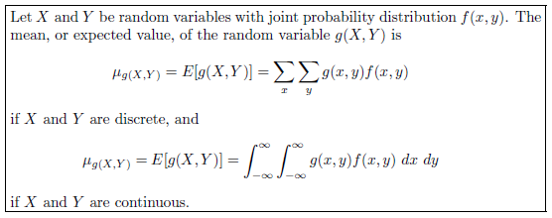
We shall now extend our concept of mathematical expectation to the case of
two random variables X and Y with joint probability distribution f(x, y).

Slide 32
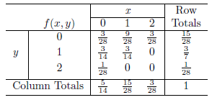
Example: Let X and Y be the random variables with joint probability distribution indicated in the following table. Find the expected value of g(X, Y ) = XY .

Slide 33
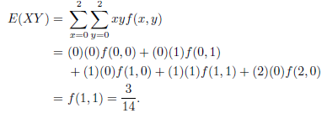

Solution: By definition, we write.
Example: Find E(Y/X) for the density function.

Slide 34
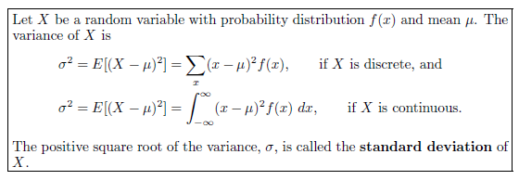
Variance and Covariance of Random Variables

Slide 35


Example: Let the random variable X represent the number of automobiles that are used for official business purposes on any given workday. The probability distribution for company A is
and that for company B is
Show that the variance of the probability distribution for company B is greater
than that for company A.

Slide 36
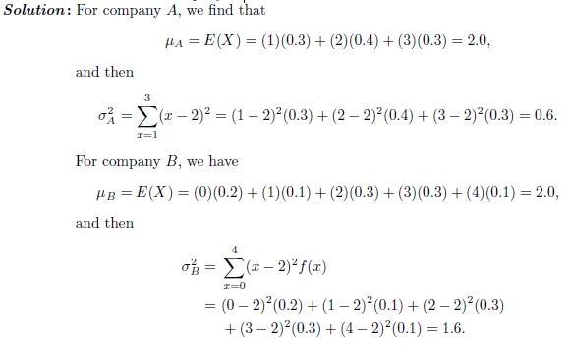
Clearly, the variance of the number of automobiles that are used for official business purposes is greater for company B than for company A.

Slide 37


Theorem:
Example:

Slide 38
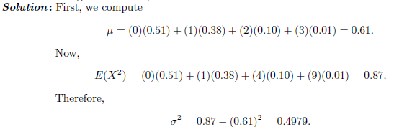
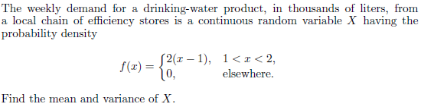
Example:

Slide 39
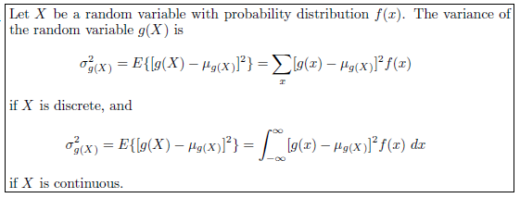

Example:

Slide 40


Solution : First, we find the mean of the random variable 2X +3
Now,

Slide 41
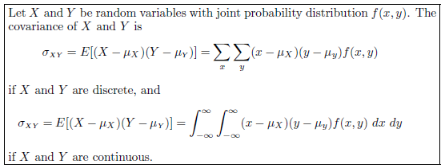

Covariance:
Theorem

Slide 42
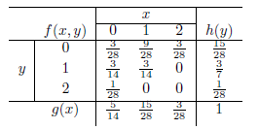

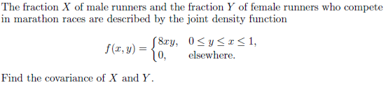
Example: For the following joint probability distribution:
Find the covariance of X and Y .
Solution hint: Use the previous theorem. And answer is
Example:

Slide 43
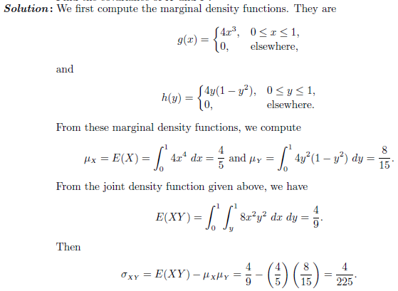

Slide 44
Moments and moment’s generating function
&
Characteristic functions

Slide 45
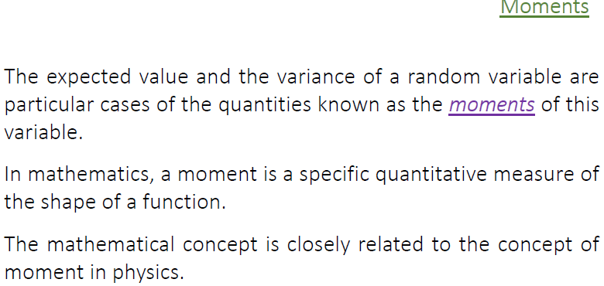

Slide 46
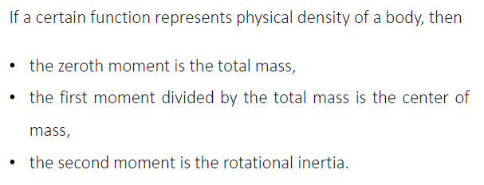

Slide 47
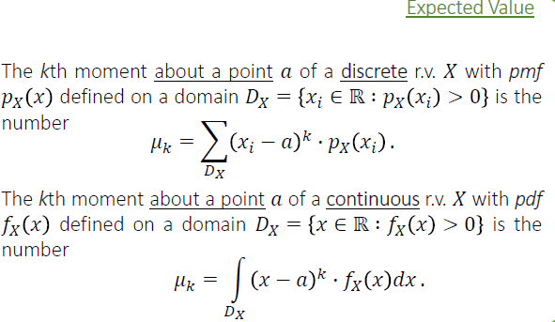

Slide 48
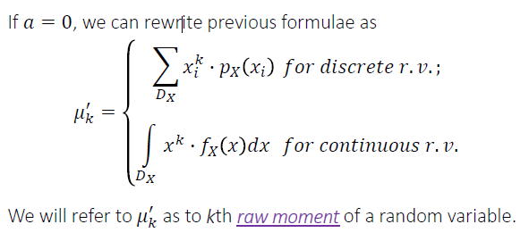
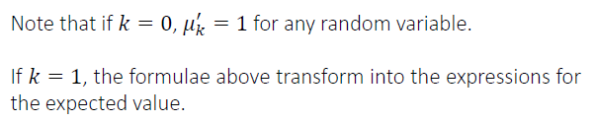
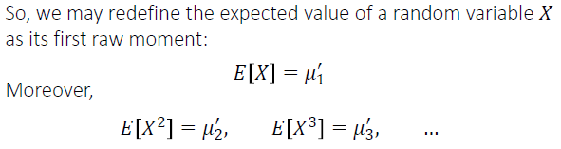

Slide 49
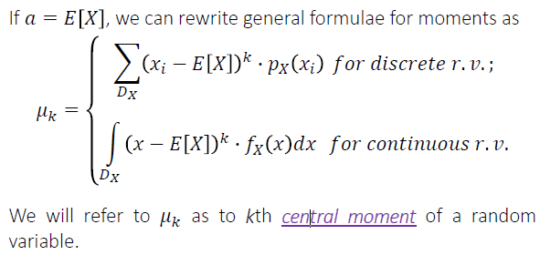



Slide 50
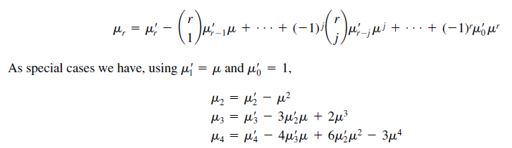
Relationship between the central moments and raw moments:

Slide 51
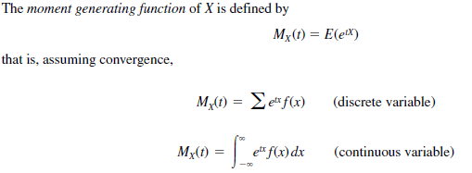

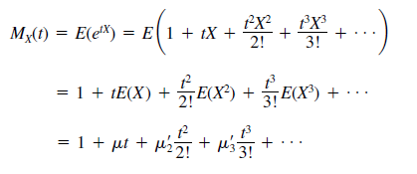
Moment Generating Functions
We can show that the Taylor series expansion of MGF is
Using the power series expansion

Slide 52
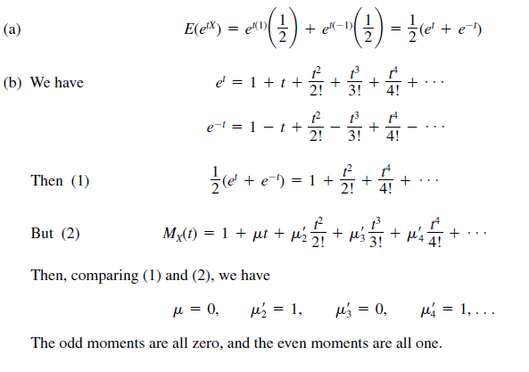
Example: The random variable X can assume the values 1 and -1 with probability each 1/2. Find (a) the moment generating function, (b) the first four moments about the origin.
Solution:

Slide 53
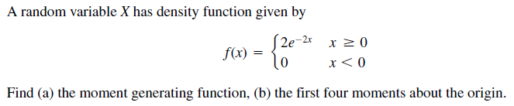

Example:
Solution:

Slide 54



Example:
Solution:
(b) Using the relationship between the central and moments, we have

Slide 55



Characteristic Functions
Example: Find the characteristic function of the random variable X having density function given by
Solution:
using Euler’s formulas

Slide 56

Example:
Solution:

